Slide 1
Country Segmentation
Divya Selvaraj

Slide 2
Project Goal
DataSet
Exploratory Data Analysis
Principal Component Analysis
Hierarchical Clustering
K-Means Clustering

Slide 3
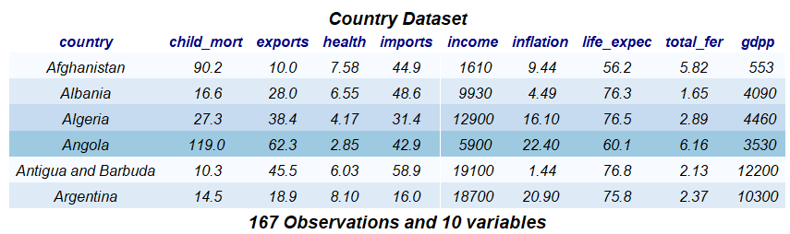
Goal
To categorize countries based on their socio-economic and health factors that determine the overall development of the country by using unsupervised learning techniques.
Dataset
One observation per country
No null values in the dataset.

Slide 4
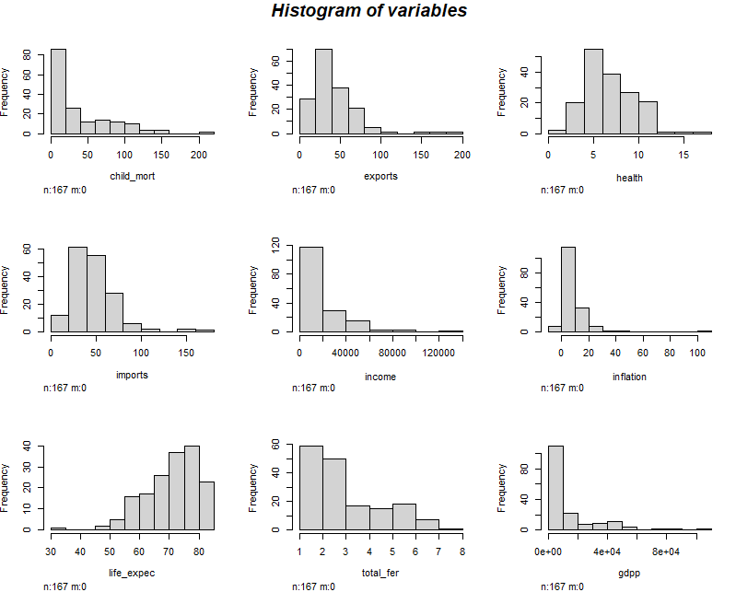
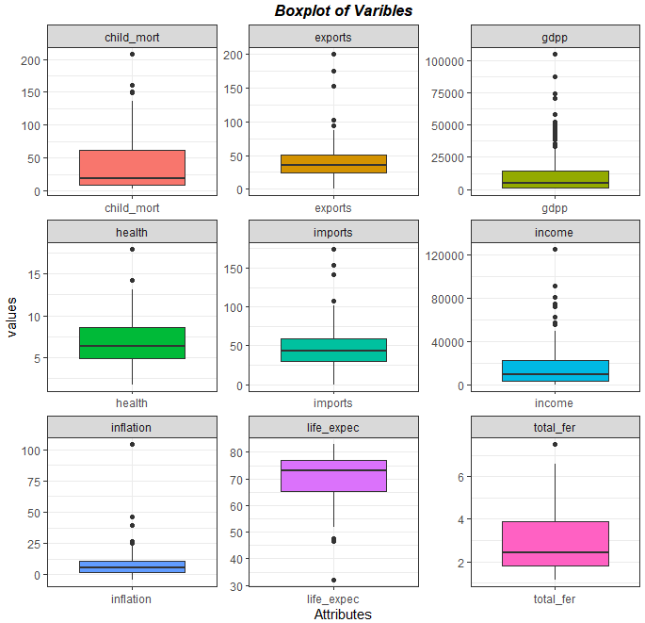
Exploratory Data Analysis
Insights:
Histogram shows that the variables do not have a normal distribution.
Boxplot shows that all the variables have outliers. Since there can be countries with extreme values we will not impute or remove these values. The scale of variables is also different for variables.

Slide 5
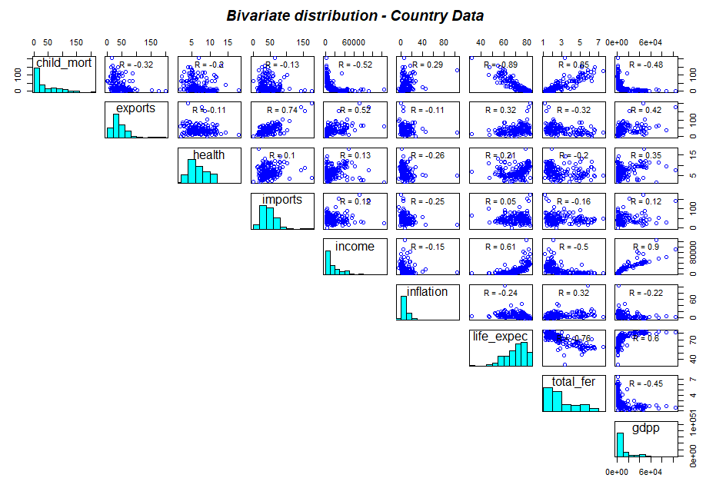
Exploratory Data Analysis(contd..)
Insights:
total_fer and child_mort has positive relationship.
Child_mort and gdpp has negative relationship.
Life_expec and gdpp has positive relationship.
total_fer and life_expec has negative relationship.

Slide 6
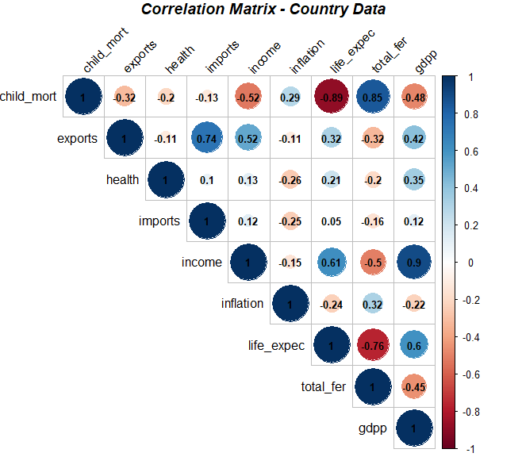
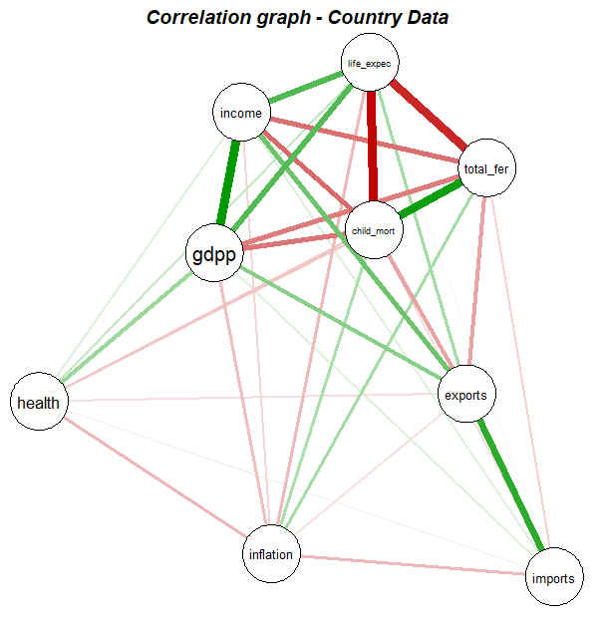
Exploratory Data Analysis(contd..)
Positive Correlation:
Income and gdpp are highly correlated with correlation coefficient of 0.9. Higher the income of the country, higher its gdpp.
Negative Correlation:
Child_mort and life_expect have high negative correlation with correlation coefficient of -0.89. Higher the child mortality rate, lesser the life expectancy.

Slide 7
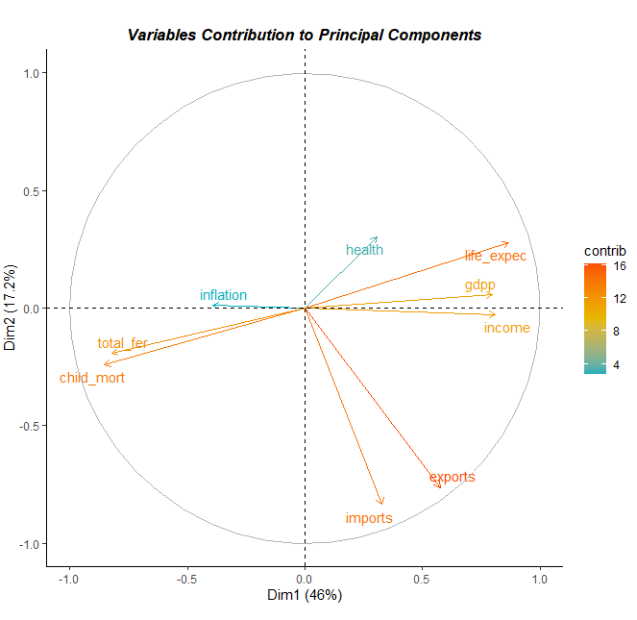
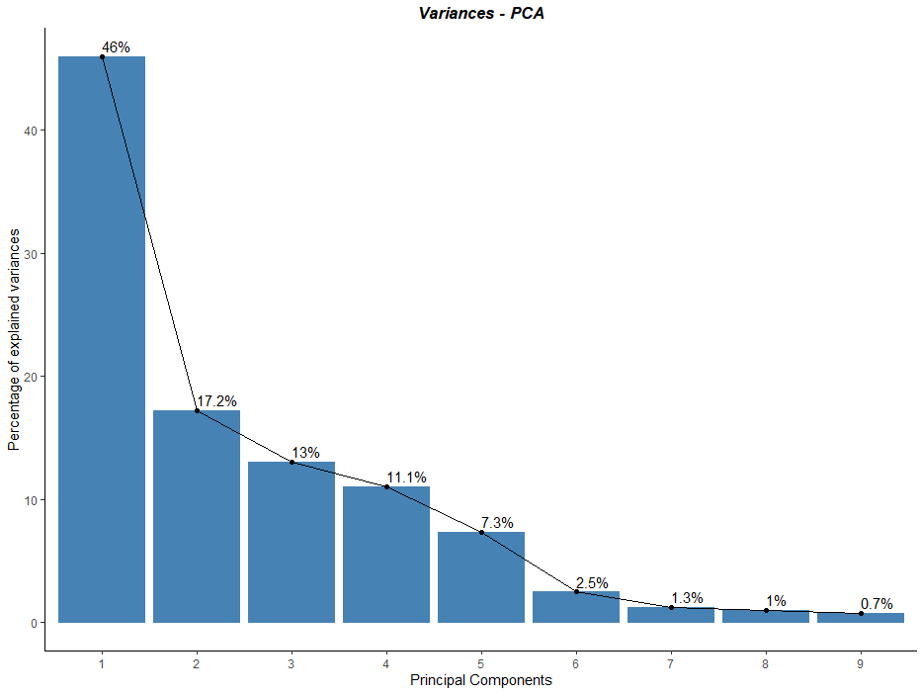
Principal Component Analysis(PCA)
Observations:
The first dimension explains about 46% of variability and second dimension explains about 17% of variability in the dataset.
About 95% of the variability in the dataset can be explained by the first 5 principal components.

Slide 8
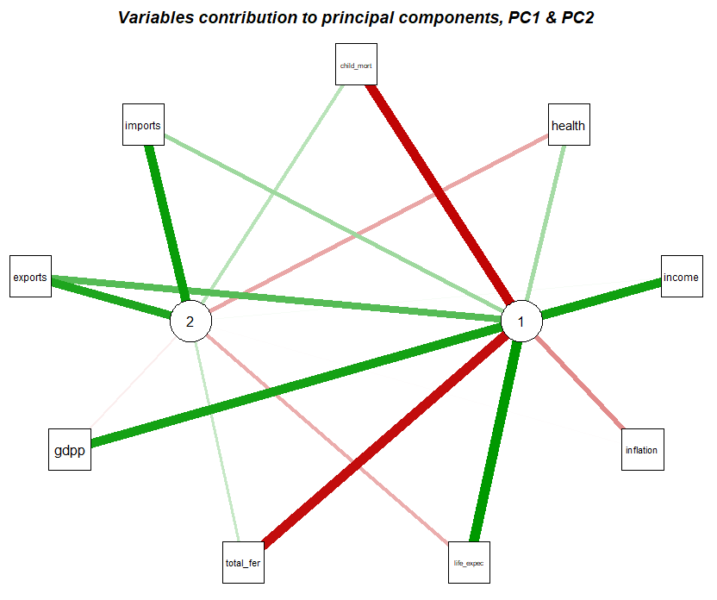
PCA(contd..)
From the network graph,
life_expec, gdpp and income contribute more to PC1.
variables imports and exports contribute more to PC2.

Slide 9
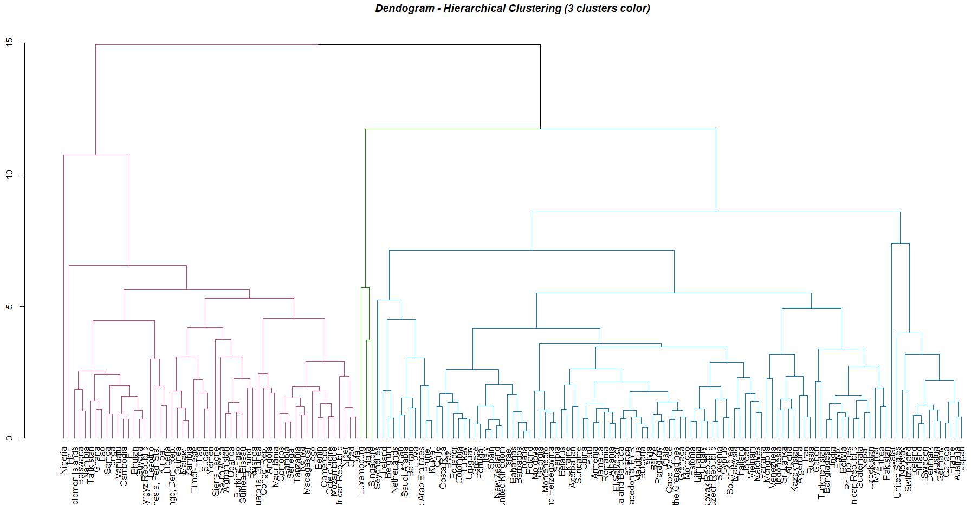
Hierarchical Clustering
Dendrogram showing three clusters from hclust (Euclidean, complete)

Slide 10
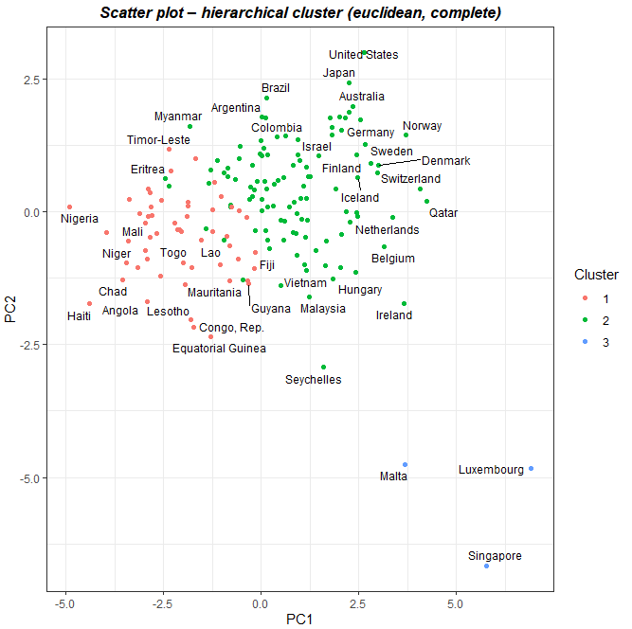
Hierarchical Clustering (contd..)
Scatter plot:
size of cluster 3 is very small.
List of countries in cluster 3 do not belong a separate cluster.
The clusters formed by hierarchical clustering complete linkage method did not create equal sized clusters.

Slide 11
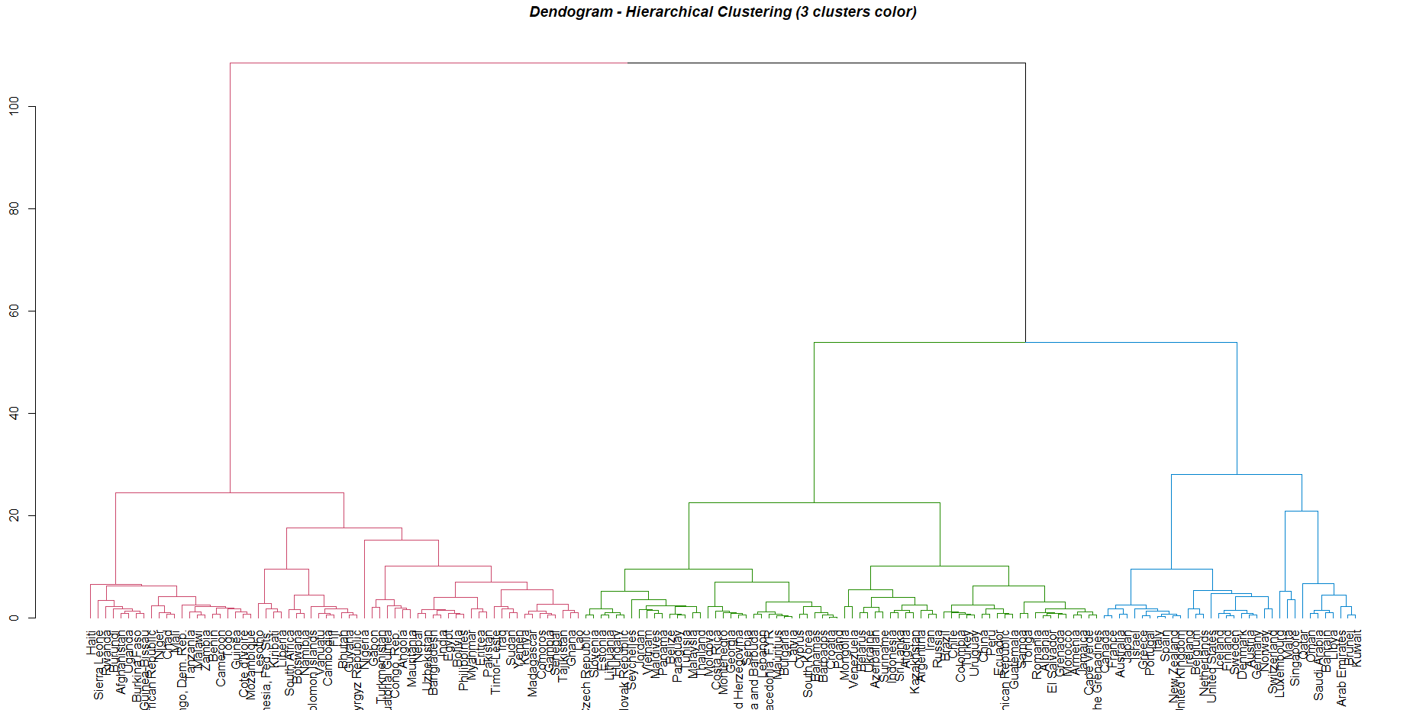
Hierarchical Clustering (contd..)
Dendrogram showing three clusters from hclust (Canberra, ward.D)

Slide 12
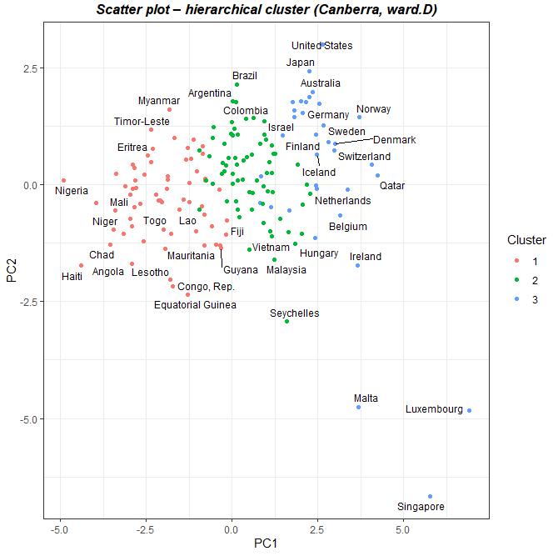
Hierarchical Clustering (contd..)
Scatter plot:
Cluster sizes are equal.
Cluster 1 marked in red has countries like Haiti, Nigeria. Congo, Rep and other African countries which might represent under-developed countries.
Cluster 2 marked in green includes countries like Brazil, Malaysia and some Asian and south American countries, which might represent developing countries.
Cluster 3 marked in blue has countries like United States, Australia, Netherlands which might represent developed nations.

Slide 13
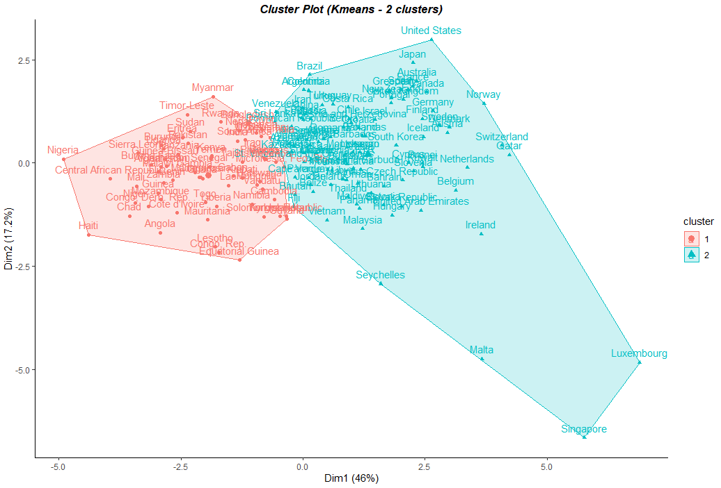
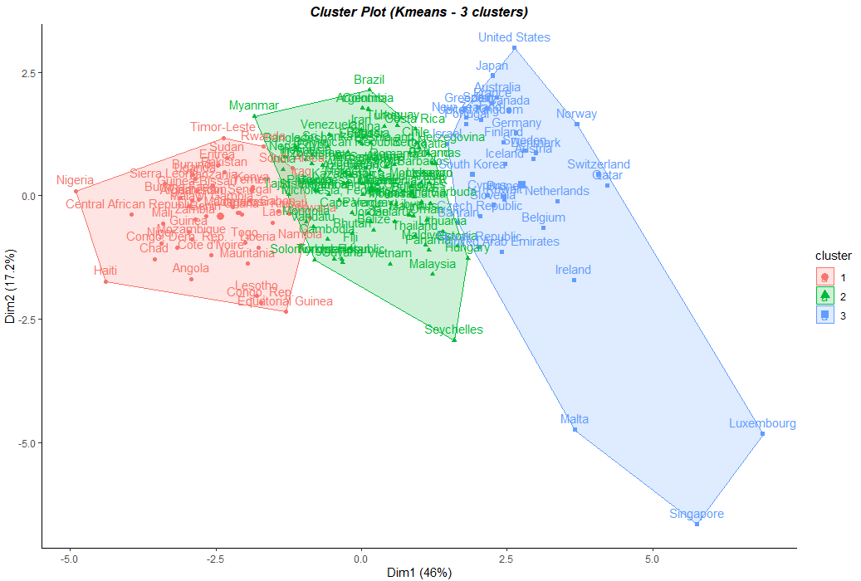
K-Means Clustering
For K=2, developed countries like United States belong the same cluster as developing nations like Thailand, Brazil, etc. Hence it may not be a good choice

Slide 14
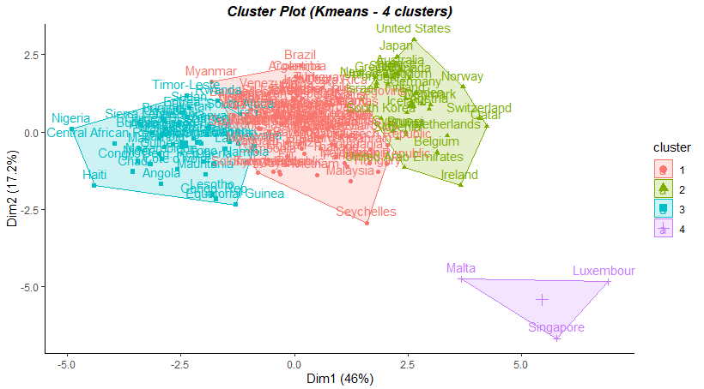
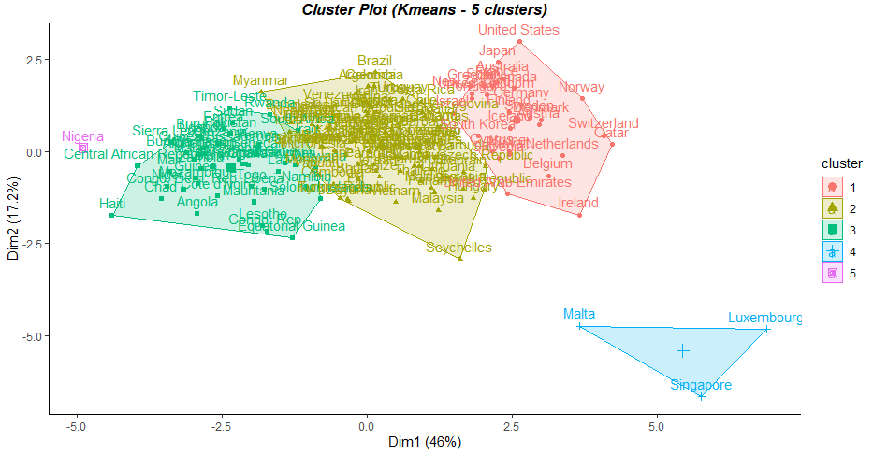
K-Means Clustering (contd..)
K = 4: only 3 observations in cluster 4
K = 5: Only 3 observations in cluster 4 and one observation in cluster 5

Slide 15
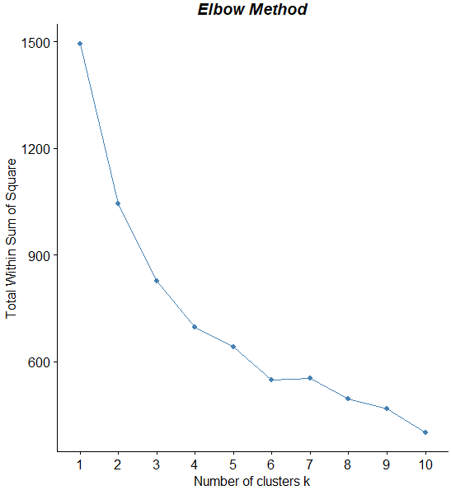
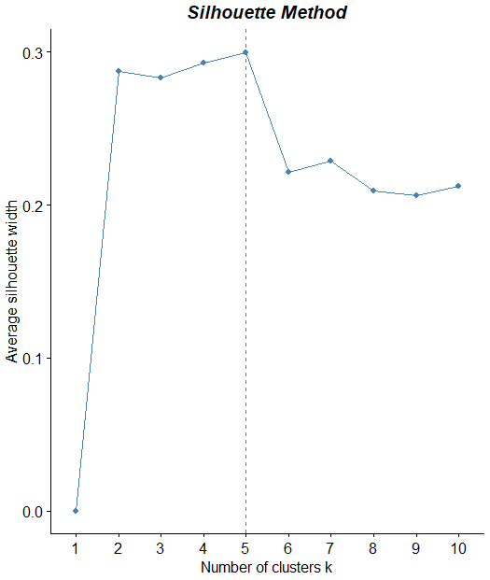
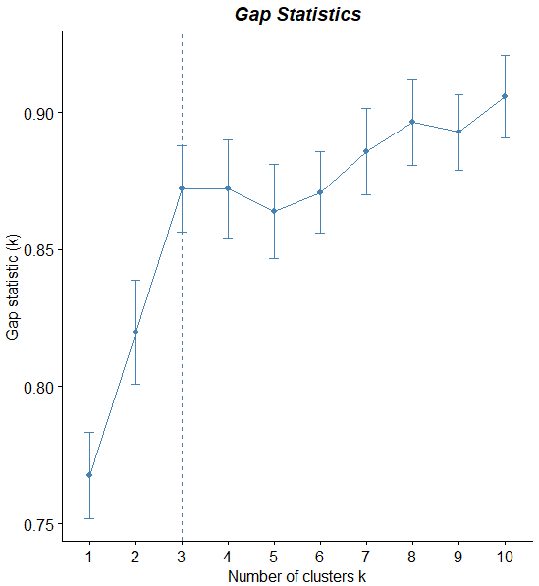
Optimal number of clusters
K-Means Clustering (contd..)
Elbow Method:
Optimal number of clusters – 4 or 6
Silhouette:
Optimal number of clusters - 5
Gap Statistics:
Optimal number of clusters - 3

Slide 16
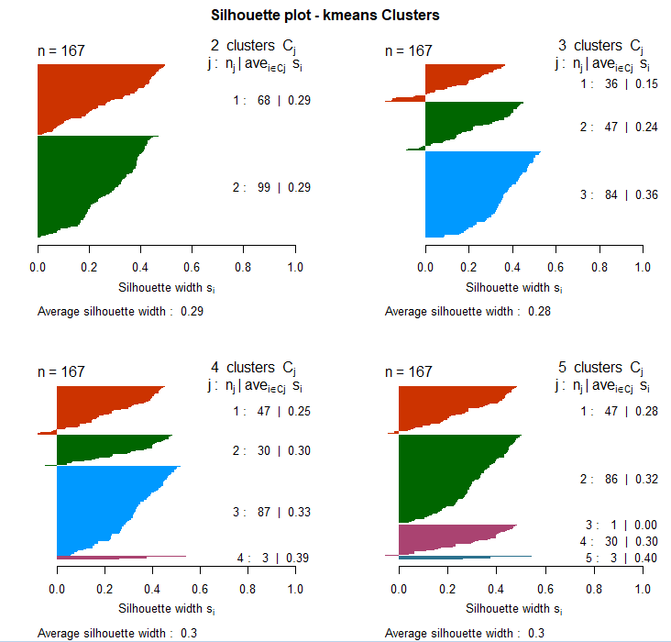
K-Means Clustering (contd..)

Slide 17
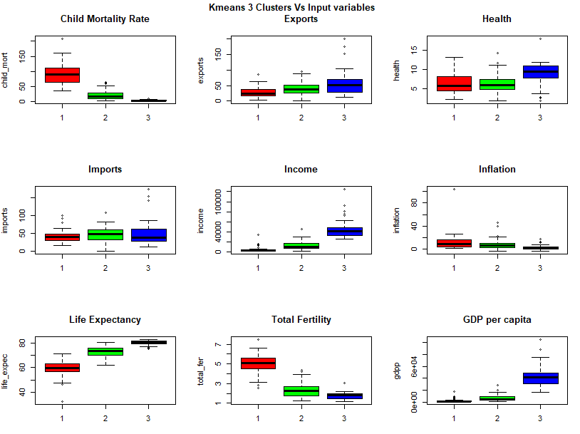
Analysis using 3 Clusters
Cluster 1: Has high child_mort, low income, low life_expec and low gdpp
Cluster 2: Has moderate values for most variables
Cluster 3: Has low child_mort, high income, high life_expec and high gdpp
Rename clusters in dataset as:
Cluster 1 => Under-Developed Countries
Cluster 2 => Developing Countries
Cluster 3 => Developed Countries

Slide 18
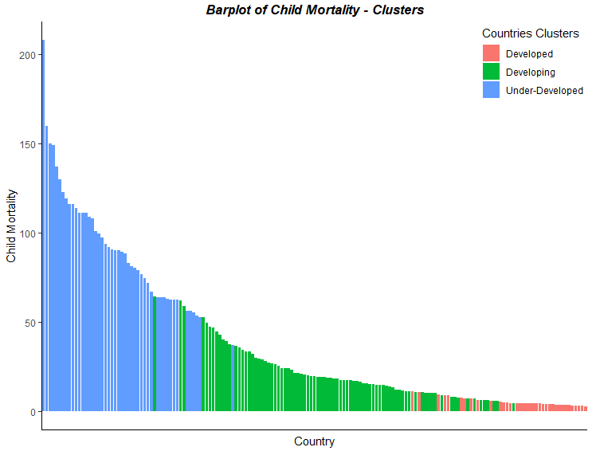
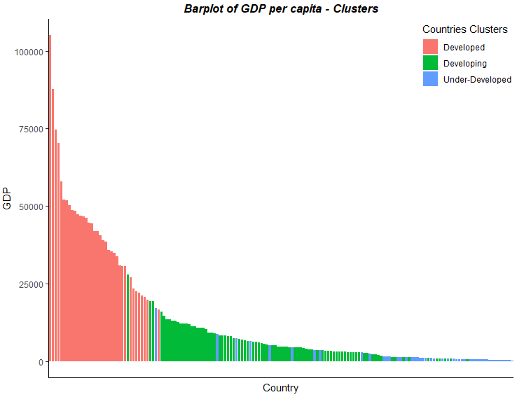
Clustered Countries – Bar plots
Child mortality is higher in under-developed countries followed by developing countries and it is least in developed countries
GDP per capita is higher developed countries followed by developing countries and it is least in under-developed countries

Slide 19
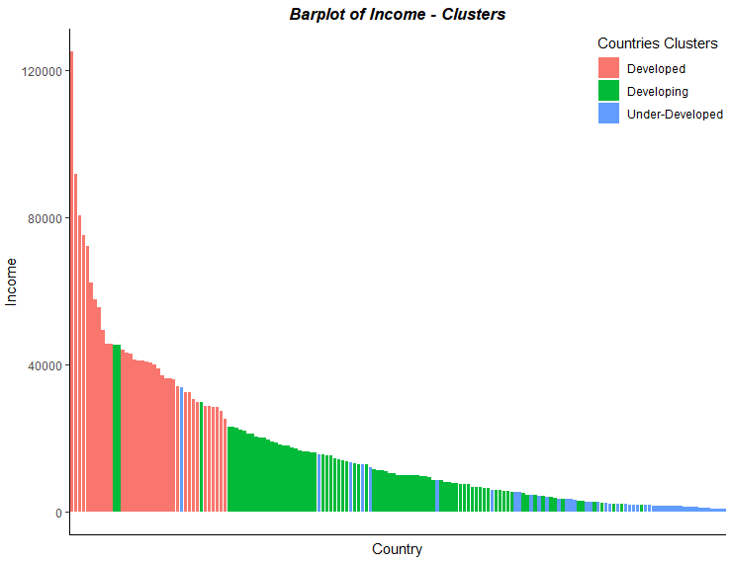
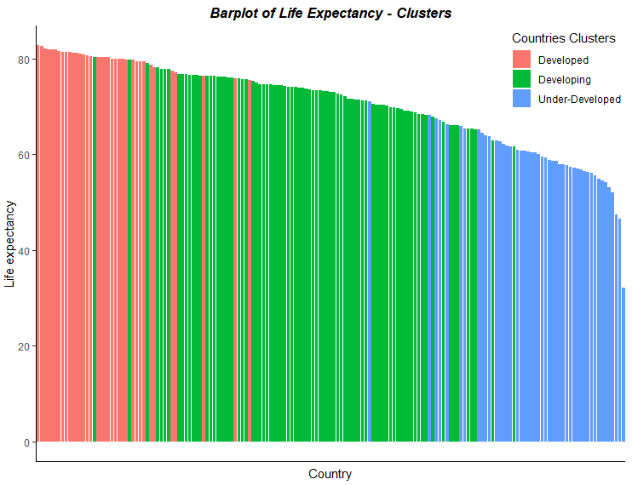
Clustered Countries – Bar plots
Income is higher in developed country.
Life expectancy is also higher with developed nations and decreasing towards developing countries and least values in under-developed countries.

Slide 20
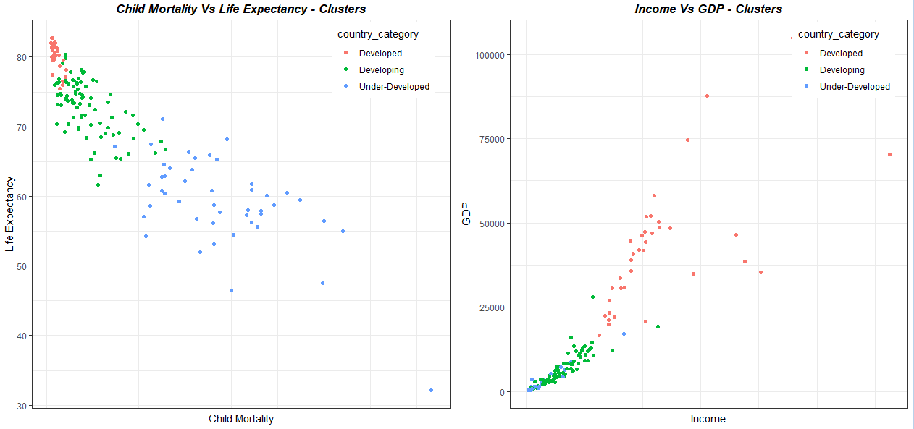
Clustered Countries – Scatter plots
Developed nations have low child mortality rates and higher life expectancy.
Under-Developed nations have low income and low gdpp,

Slide 21
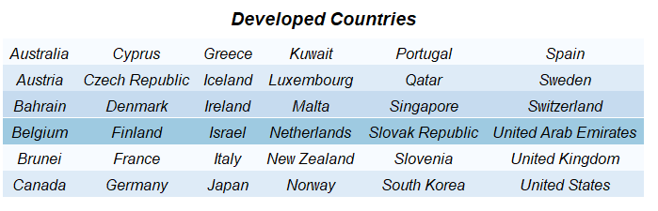
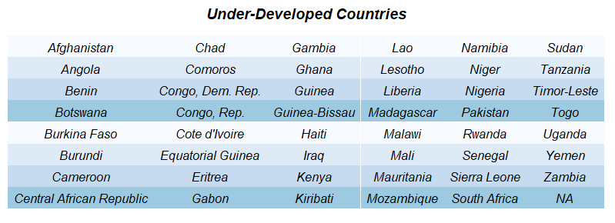
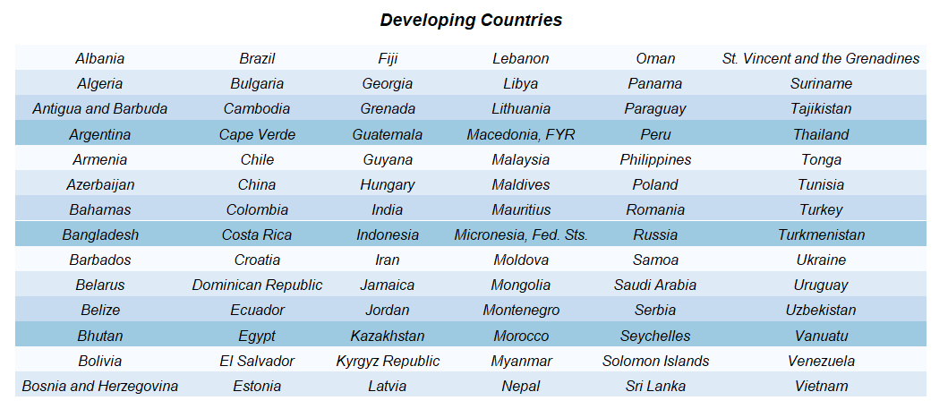
Clustered Countries - List

Slide 22
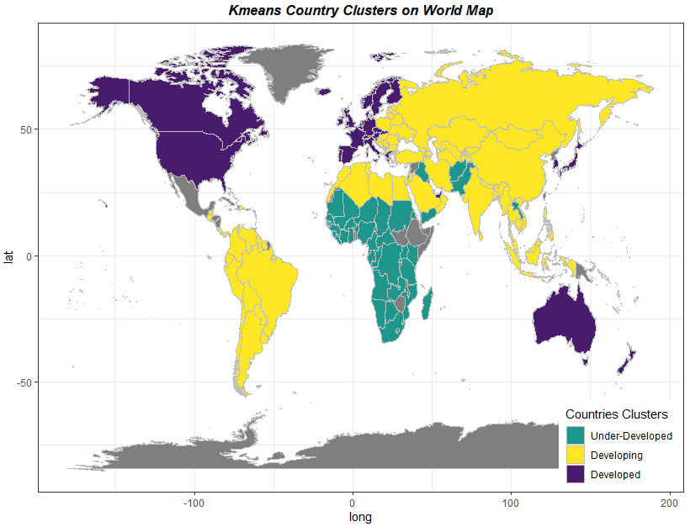
Clustered Countries – Map View
Cluster 1: (Under-Developed) has mostly African and some Asian countries.
Cluster 2 (Developing) includes mostly South American and Asian countries.
Cluster 3 (Developed) includes countries from Europe, North America, and Australia.

Slide 23
Conclusion
Unsupervised learning techniques like principal component analysis, hierarchical clustering and partitioning clustering have been applied to the dataset.
The countries are categorized into 3 clusters - developed, developing and under-developed categories.
Country clusters are visualized.

Slide 24
Thank You

